Slide 1


---------------
Challenge 1:
Optimising Emergency Response

Slide 2


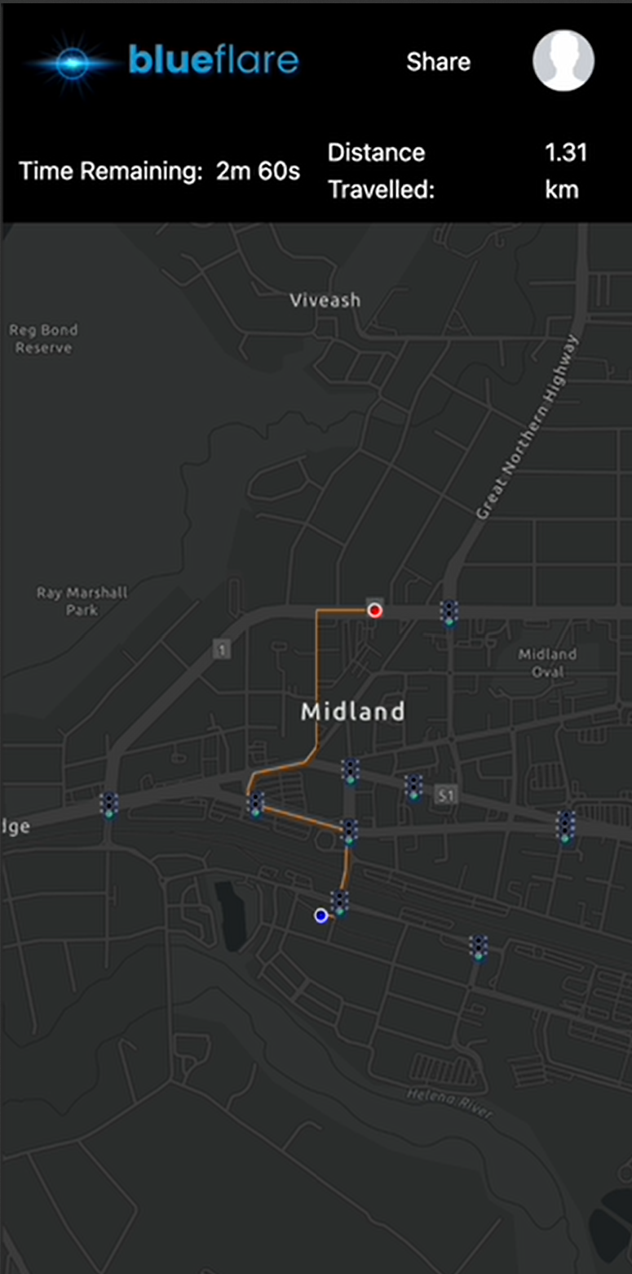
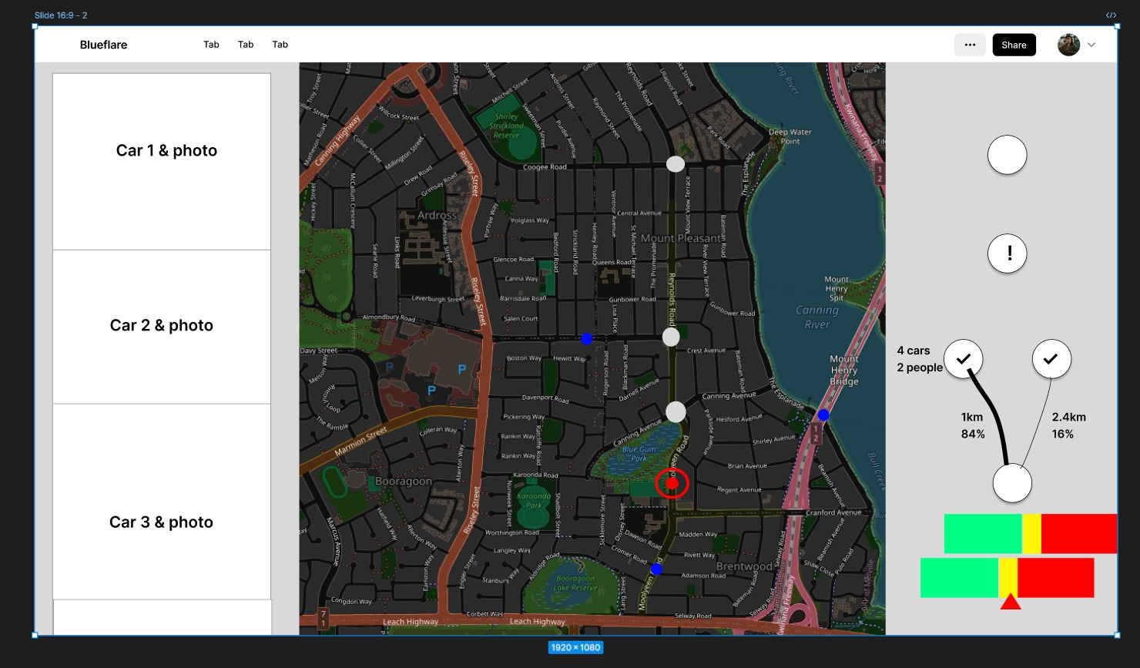

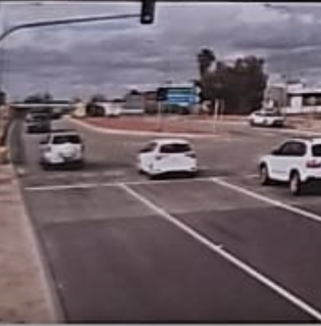
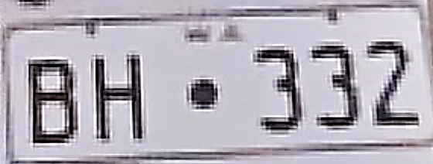


---------------
Introducing…
Traffic Signal Optimised Routing

Slide 3
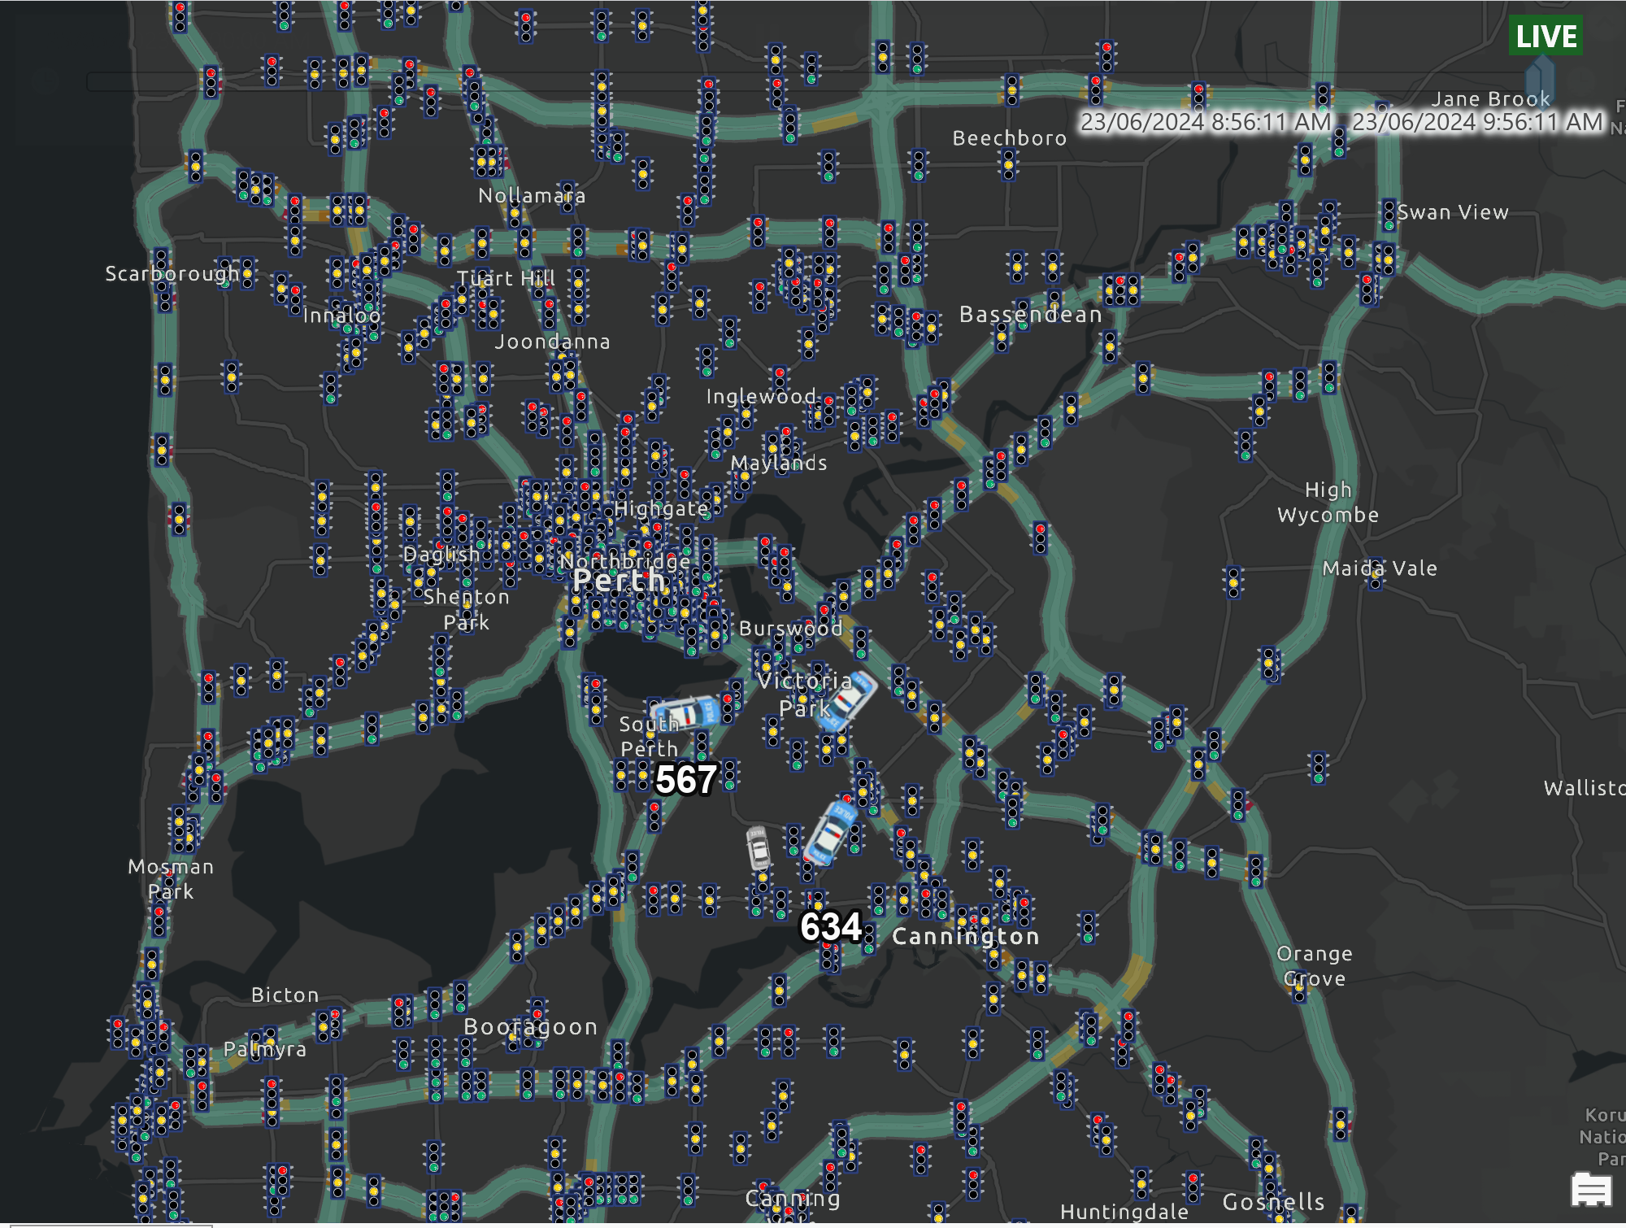

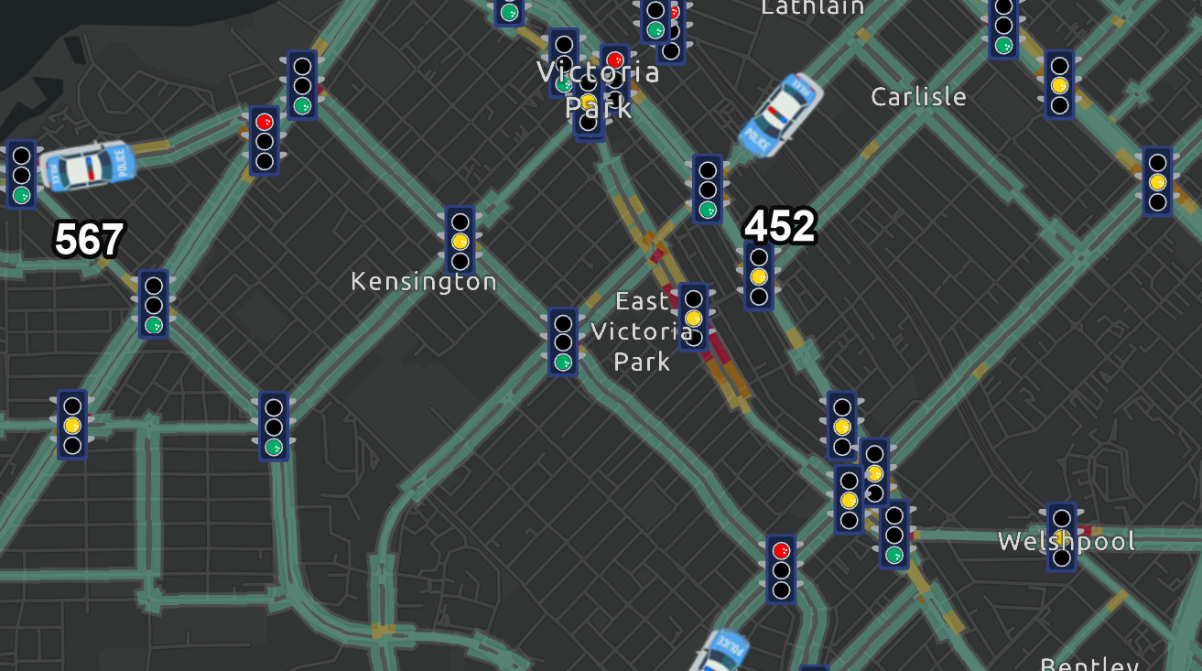
---------------
What dispatch sees…

Slide 4
---------------
WHAT
Provides a SAFE and OPTIMISED route between responding Police Vehicle and Priority 1 or Priority 2 Incident Location.
HOW
Optimise fastest route by Controlling Traffic Signals using Main Roads SCATS System
SCATS: An existing intelligent transportation system that manages the dynamic (on-line, real-time) timing of signal phases at traffic signals dependent on the traffic situation – it has the ability for manual operation
RESULT
Faster for Police and Safer for the Community
- Reducing the interaction between Police Cars and Traffic at intersections

Slide 5
---------------
APP info….

Slide 6


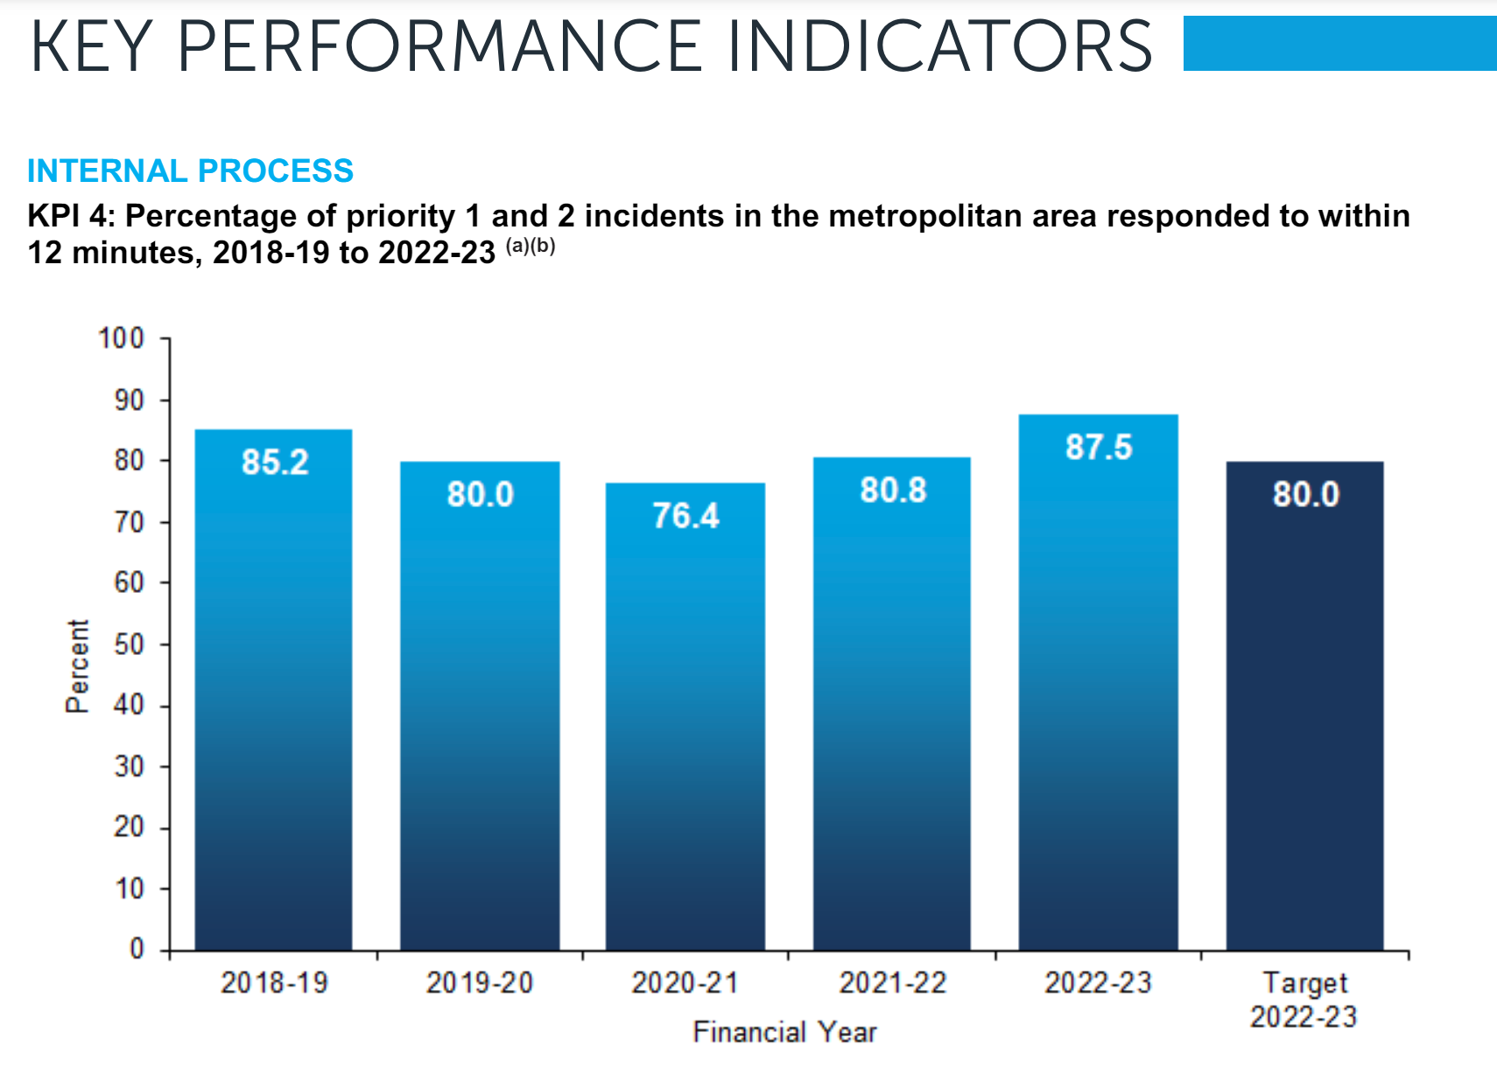
---------------
aims to:
Assist Police to Respond to Priority 1 & 2 calls for help within 12 minutes
and,
Meet Community Expectations by:
Respond to where and when the community needs Police most
Providing the community assurance of immediate safety and support
WESTERN AUSTRALIA POLICE FORCE ANNUAL REPORT 2023

Slide 7
---------------

Slide 8
---------------
What we can do
Future Opportunities:
Machine Learning to optimise all available resources and intersection manipulation – looking at every available resources and determine which resource

